Slide 1
From a controlled chaos to well oiled machine
Agile & Devops complement each other
Rajasree Talla
Lead Program Manager, New Relic Inc

Slide 2
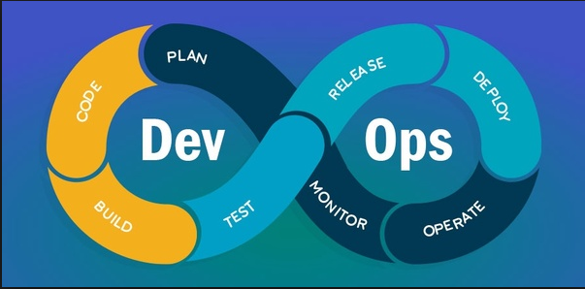
State of Devops Report
Vision, Inspirational communication, Intellectual stimulation, Supportive leadership, and Personal recognition
Transformational leaders share common characteristics
DevOps applies to all organizations
Loosely coupled architecture & teams are stronger predictors of continuous delivery
High-performing teams achieve both faster throughput & better stability
Automation is huge boon to organizations
Lean product management drives higher organizational performance
Source https://puppet.com/resources/whitepaper/state-of-devops-report

Slide 3
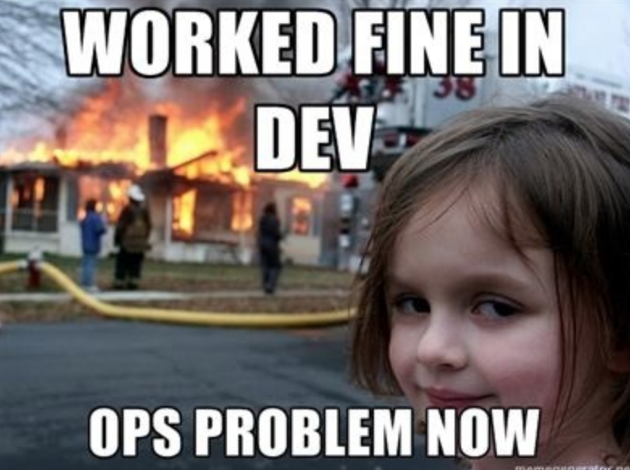
Challenge in hand
Unpredictable releases
Little to no feedback until launch
Long hardening cycle - 8 weeks
Water - Scrum - fall
Continuous integration always red
Code in production only after release

Slide 4
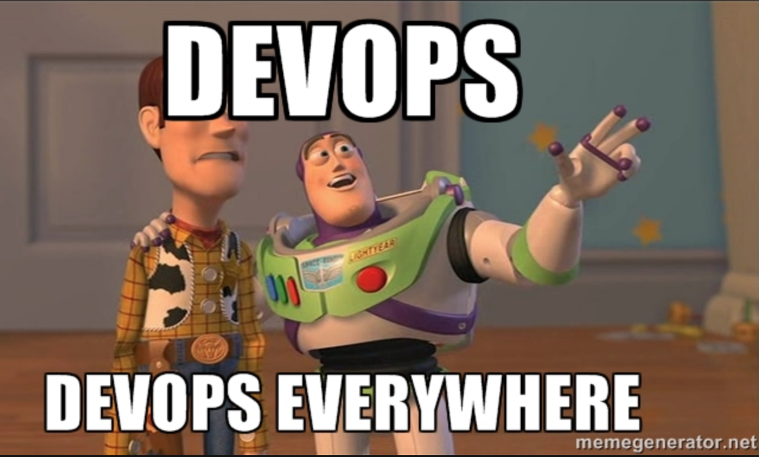
Bright new world!
Continuous Integration green
Continuous delivery + deployment
Hardening for GA is less than a week
Being agile
Feedback in entire release cycle

Slide 5
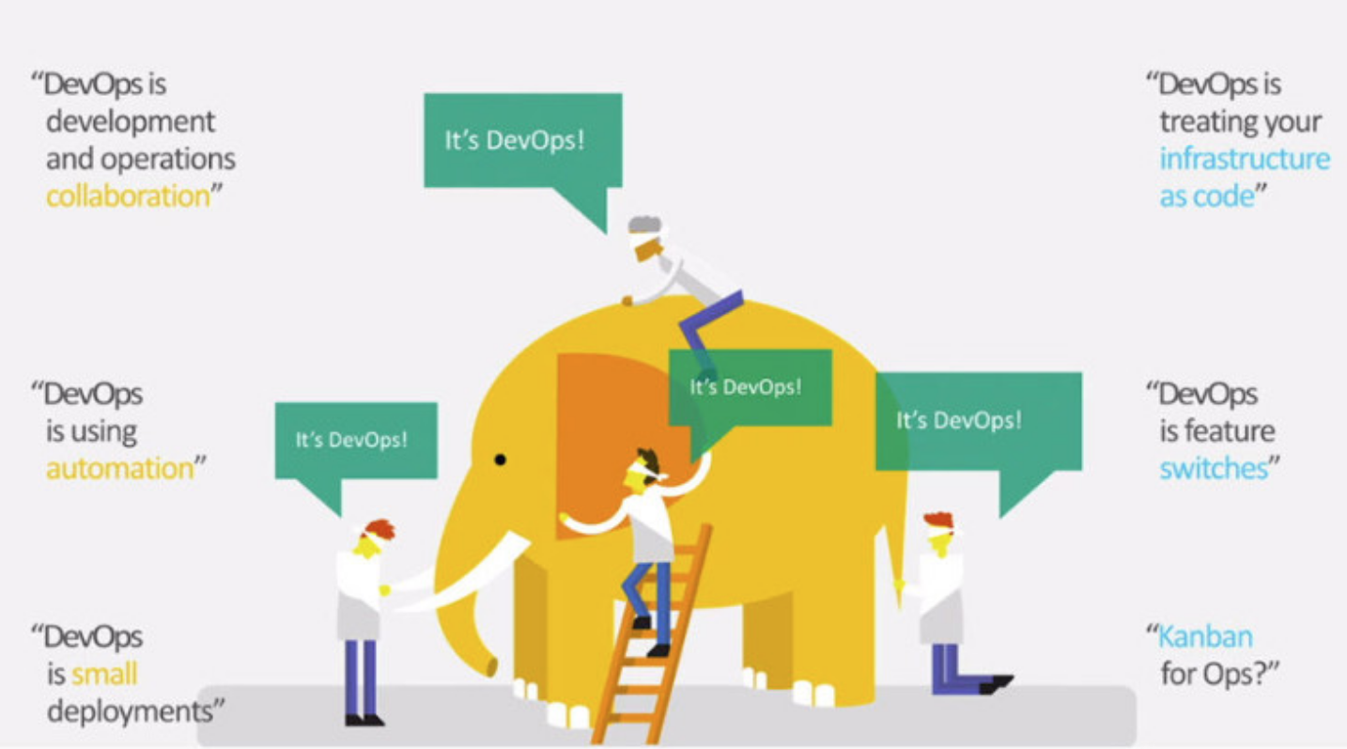
Approach
Adopting
Continuous Integration
Continuous delivery
Continuous deployment
Iterative development
Feedback loops

Slide 6
Adopting Continuous integration, delivery & deployment isn’t easy
Continuous Integration
Continuous Delivery
Continuous Deployment
Promoting code early & often
Reduced feedback time for Dev check-ins
Maintaining CI system green
Release at end of every sprint
Quality of build equal to general availability
Release branching
Using IT Ops team as customer#0
Build deployed to production every sprint by customer #0
Customers deploying beta build

Slide 7
Iterative development : Being Agile
Small batches of work - incremental value add
Autonomous & self sustaining teams
Inheriting agile principles improved quality of work

Slide 8
Feedback loops: Build, Measure & Learn
User story lifecycle
Technical advisory board
Test Pilots (UX research)
Internal Customer#0 program
Feedback loops
Beta program
Early access to partners

Slide 9
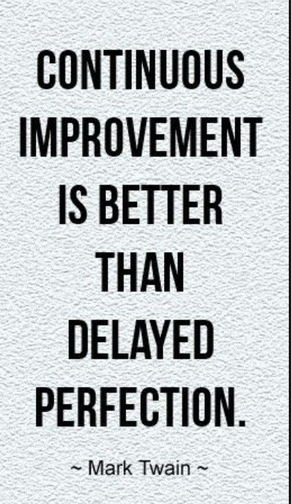
Key Learnings
Be effective before being efficient
Business deadlines are unavoidable
User story definition to delivery in a single sprint is challenging
Cross-functional team together doesn’t mean agile
Tooling & process is just not enough
Shift to customer lens by incorporating feedback loops

Slide 10
Being Agile is a mindset shift
Practicing Devops is a culture shift
and they complement each other

Slide 11
Thank you
Twitter: rajasree_talla
Linkedin: Rajasree Talla
Good reads
Devops Handbook - https://www.amazon.com/DevOps-Handbook-World-Class-Reliability-Organizations/dp/1942788002
Phoenix Project - https://www.amazon.com/Phoenix-Project-DevOps-Helping-Business/dp/0988262592
Human side of agile - https://www.amazon.com/Human-Side-Agile-Help-Deliver/dp/0988001624
Agile Mindset -https://www.amazon.com/Agile-Mind-Set-Making-Processes-Work-ebook/dp/B014CA3YKG
What is devops - https://puppet.com/blog/what-is-devops
State of Devops report - https://puppet.com/resources/whitepaper/state-of-devops-report

